Slide 1
Numerical Analysis of Boundary Value Problem Using the Shooting Method
Kritika Verma

Slide 2
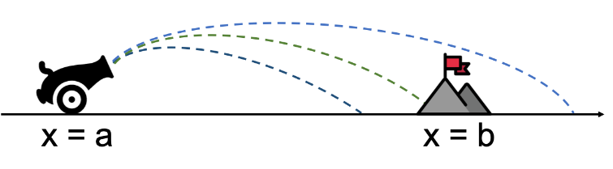
Introduction to the shooting METHOD
Shooting method is a numerical method used for numerical analysis of boundary value problems by using the given boundary conditions to “shoot” an initial condition with satisfies those boundary conditions.
It involves finding a solution initial condition for different initial value problems until we find the solution which also satisfies the boundary conditions of the boundary value problem.
In other words, we shoot out trajectories in different directions towards a particular boundary condition until we find an initial condition that hits it. Hence, its name the shooting method.

Slide 3
INTRODUCTION TO THE SHOOTING METHOD
The shooting method is used to solve boundary value problems where the boundary conditions are given but initial condition is missing.
In this presentation we’ve talked about:
Linear Second Order ODEs
Non-Linear Second Order ODEs
Though both types of problems can be used solving according to Euler’s method as well as the Runge-Kutta method but here we have focused mostly on the Euler’s Method.

Slide 4

Linear ${\text{2}}^{nd}$ORDER ODE

Slide 5
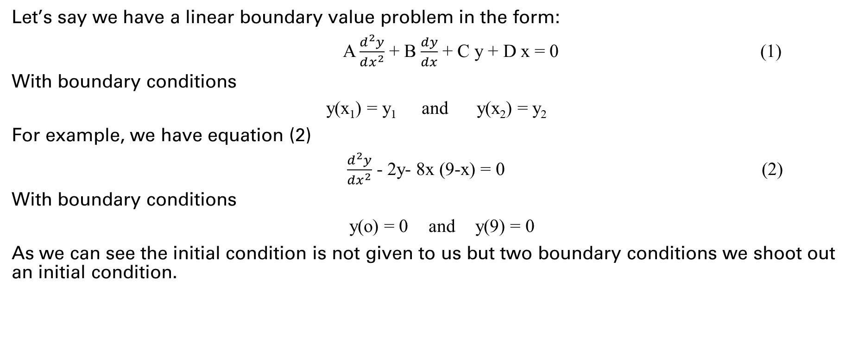
METHODOLOGY
Let’s say we have a linear boundary value problem in the form:
A $\frac{d^{2}y}{dx^{2}}$ + B $\frac{dy}{dx}$ + C y + D x = 0 (1)
With boundary conditions
y(x₁) = y₁ and y(x₂) = y₂
For example, we have equation (2)
$\frac{d^{2}y}{dx^{2}}$ - 2y- 8x (9-x) = 0 (2)
With boundary conditions
y(o) = 0 and y(9) = 0
As we can see the initial condition is not given to us but two boundary conditions we shoot out an initial condition.

Slide 6
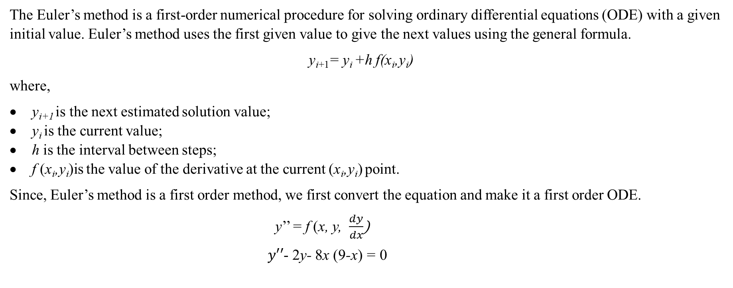
Using Euler’s Method
The Euler’s method is a first-order numerical procedure for solving ordinary differential equations (ODE) with a given initial value. Euler’s method uses the first given value to give the next values using the general formula.
y_{i+1}= y_{i} +h f(x_{i},y_{i})
where,
y_{i+1} is the next estimated solution value;
y_{i} is the current value;
h is the interval between steps;
f (x_{i},y_{i})is the value of the derivative at the current (x_{i},y_{i}) point.
Since, Euler’s method is a first order method, we first convert the equation and make it a first order ODE.
y’’ = f (x, y, $\frac{dy}{dx}$)
$y′′$- 2y- 8x (9-x) = 0

Slide 7

Using Euler’s Method
Since, Euler’s method is a first order method, we first convert the equation and make it a first order ODE.
y’’ = f (x, y, $\frac{dy}{dx}$)
$y′′$- 2y- 8x (9-x) = 0
1) Let’s take
$\frac{dy}{dx}$=z = f₁ (x,y,z)
for the given boundary condition y(0)=0.
2) Similarly,
$\frac{dz}{dx}$=y’’ = f₂ (x,y,z) =2y+8x(9-x)
for our initial condition y’(0)=z(0)=4.

Slide 8

Using Euler’s Method
For Euler’s method we have,
y_{i+1}= y_{i} +f₁(x_{i},y_{i,},z_{i})*h
z_{i+1}= z_{i} +f₂(x_{i},y_{i,},z_{i})*h
We are taking h=3.
At i=0
y₁= y₀ +f₁(x₀,y_{0,}z₀)*h
z₁= z₀ +f₂(x₀,y_{0,},z₀)*h
x₀₌0; y₀=0; z₀=4; h=3
Calculation with equation 15 we get,
y₁= y₀ +f₁(x₀,y_{0,}z₀)*h
= 0 +f₁(0,0,4)*3=0+4*3=12
z₁= z₀ +f₂(x₀,y_{0,},z₀)*h
= 4+[2y+8x(9-x)]*3=4+0=4
y(x₁)$≈$y₁=12
z(x₁)$≈$z₁=4
x₁=3

Slide 9
Using Euler’s Method
Since, our guess was wrong, lets take any other arbitrary value for initial value problem.
Say,
y’(0)=-24
After going through all the steps of the Euler’s Method we get,
i | x_{i} | y_{i} | z_{i}
0 | 0 | 0 | -24
1 | 3 | -72 | -24
2 | 6 | -144 | -24
3 | 9 | -216 | _
Table 1.1 Solutions of Euler’s Method at y’(0)=4
y(x₃)=y(9)=-216

Slide 10
Interpolation Technique
Since, we can’t keep making random guesses. Fortunately, we can make are next value more accurate by using the formula to get straight line with two points.
guess 3=guess 2+m(target−solution 2)
m=(guess 1−guess 2)/(solution 1−solution 2)
Using formula 35 and 36 we get
y’(0)=-21.57

Slide 11
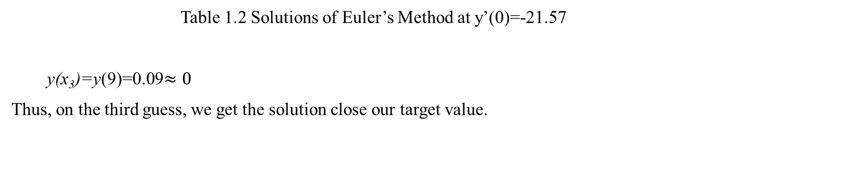
Interpolation Technique
The solution we from this guess are:
i | x_{i} | y_{i} | z_{i}
0 | 0 | 0 | -21.57
1 | 3 | 7 | -21.57
2 | 6 | -123.42 | -24
3 | 9 | 0.09 | _
Table 1.2 Solutions of Euler’s Method at y’(0)=-21.57
y(x₃)=y(9)=0.09$≈0$
Thus, on the third guess, we get the solution close our target value.

Slide 12
Runge-Kutta Method
Using the Runge-Kutta second derivative method for
y’(0) = 4
we get, y(9)=25200
Taking our second guess as
y’(0) = -24
we get,
y(9)=-1512
Using formula 35 and 36 we get
y’(0)=-18.8679
We got
y(9)= 3384.0234
As we can see that well have to use the method again a few times in order to get correct solution while using the Runge-Kutta Method.

Slide 13
Non Linear 2nd ODE
The process to solve the non-linear second order ODE is same as that of the linear ODE with one difference being that instead of getting to the target value that satisfies the boundary equation in just three iterations.
It takes more iterations to get to the target value while solving the non-linear second order ODE which can be done more efficiently using MATLAB loop until we get the initial condition which satisfies the given boundary condition.

Slide 14
RESULTS AND CONCLUSION
We were successful in solving the linear ordinary differential equation using Shooting method with the help of Euler’s Method which was found to be more efficient than Runge-Kutta method in the three iterations.
For non-linear ODE a while loop had to be put for when the condition was satisfied rather than using just 3 iteration and the result came out be that iterations we needed to get to the target value.
Shooting method can be useful in solving second order ODEs where only boundary conditions are given. It is easy and uses Euler’s method or Runge-Kutta method to find the initial value problem with accuracy. Like how a cannon shooting out an object and adjusting its trajectory after every shot to land the object on a given mark, shooting method shoot the initial condition towards what can actually be the condition which satisfies the boundary conditions. The guess is adjusted with the help of interpolation which makes the next guess more accurate and hence closer to the target.

Slide 15
REFERENCES
Introduction to shooting method: https://kyleniemeyer.github.io/ME373-book/content/bvps/shooting-method.html [accessed on 7 December 2022]
Shooting Method Definition: https://pythonnumericalmethods.berkeley.edu/notebooks/chapter23.02-The-Shooting-Method.html [accessed on 5 Dec 2022]
Shooting method: https://en.wikipedia.org/wiki/Shooting_method#:~:text=In%20numerical%20analysis%2C%20the%20shooting,to%20an%20initial%20value%20problem. [accessed on 5 December 2022]
Shooting method lesson 1: https://www.youtube.com/watch?v=ZMgikZ-lcS8&ab_channel=numericalmethodsguy [accessed on 5 December 2022]
Shooting method lesson 2: https://www.youtube.com/watch?v=R7I8FrlB_KM&ab_channel=numericalmethodsguy [accessed on 5 December 2022]
Shooting method lesson 3: https://www.youtube.com/watch?v=UmSVUqkKvrE&ab_channel=numericalmethodsguy [accessed on 5 December 2022]

Slide 16
Thank you
Kritika Verma
B Tech (IT and MI)
152123

